Slide 1
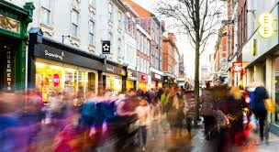
Marketing Segmentation and Groups of Potential Customers Student’s Name
Institutional Affiliation
Notes:
This presentation is about market segmentation based on the marketing objectives that should be applied in the case of Hyatta campaign. Hyatta is top notch hospitality industry so it wants to campaign for its slogan “Its Good Not to Be Home”.
In this scenario marketing segmentation refers to a group of individuals that share a common characteristics, categorized together for purposes of marketing. Applying this to Hyatta hotels, since it has branches in Vancouver, Calgary and Toronto, it means every market segment is unique.

Slide 2
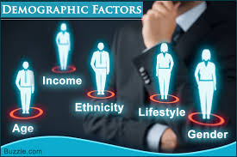
Demographic Segmentation
The commonest
Deals in market divisions
Depended on traits
Identifies each group
Notes:
Demographic market segmentation is among the commonest market segments. It applies a strategy where the company divides the larger market into smaller groups.
The division factors is normally based on traits such as race, age, gender, education, income and occupation. So the Hyatta company can utilize this segment by selling foodstuffs that can be consumed by people of all traits.

Slide 3
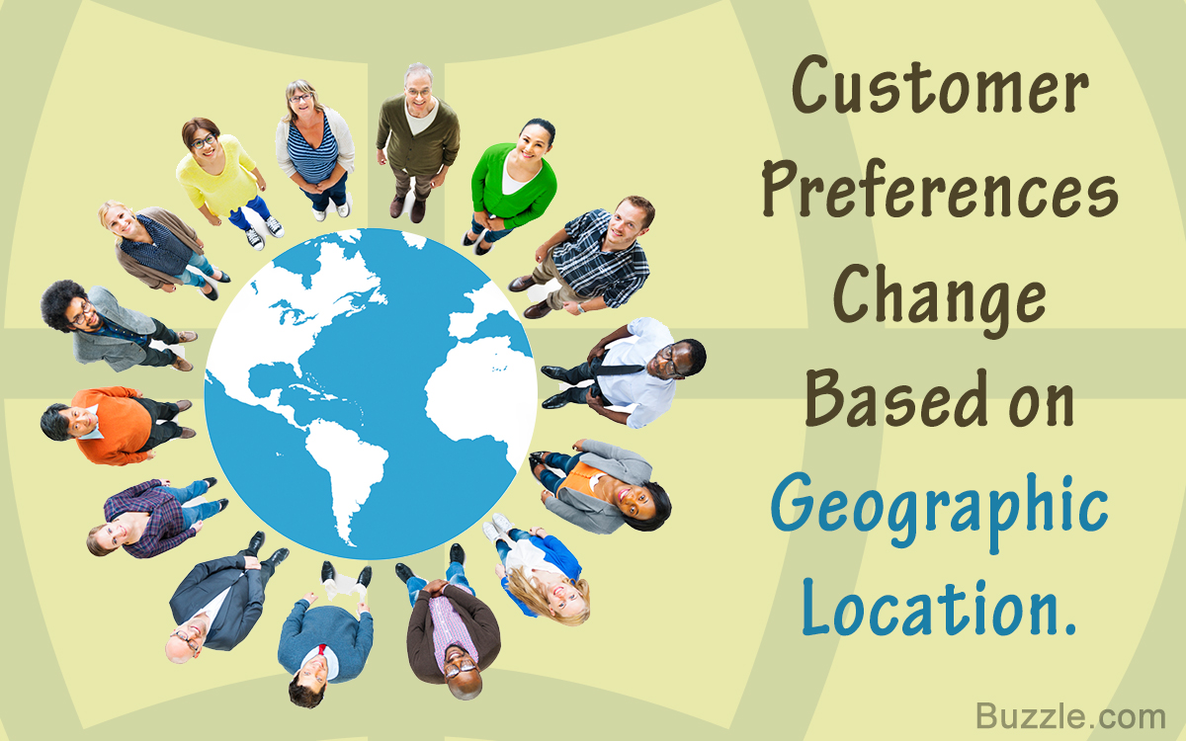
Geographical Segmentation
Focuses on communities, states, region country or group of countries (Armstrong et al., 2015)
Advertising works well
Market is defined separately
Notes:
Geographic segmentation can help the Hyatta hotels to sell products to certain group of people that have high test for its products (Armstrong et al., 2015).
It can also decide to set up branches in various countries just like it has done in Canada. In the UK it has already targeted three cities Toronto being included.
Adverts are key in this segment as the company can use national radios, televisions, newspapers and magazines to access the prospective nationally. The Hyatta hotels can choose to maintain a universal message or disseminate messages to every area of marketplace.

Slide 4
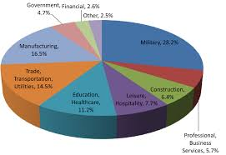
Psychographics Segmentation
Targets the camping enthusiasts
Outdoor hobbyist
Works on the basis of interests and activities
Notes:
Since camping enthusiasts are potential customers in this demographic it means there are reduced traits.
According to Kwac et al. (2014), businesses can provide commodities that match the interests and activities of prospects. All the products sold in lieu of demographics should have a test of current and health lifestyle.
Therefore, the industry can opt to target an outdoor hobbyists via outdoor programs or magazines

Slide 5
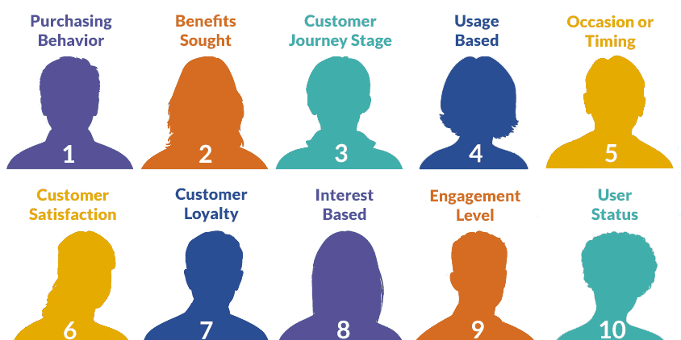
Behavioral Tendency Segmentation
Determined by customer behaviors
Patterns of use and price sensitivity
Defines the scope of product use
Value orientation is paramount
Notes:
Behavioral segmentation is greatly determined by customer behaviors such as pattern in which he or she uses a commodity, the sensitivity about prices of items, benefits of sought and brand loyalty.
It can happen that Hyatta hotels have customers bearing same demographic behaviors but discrete behavioral tendencies. Some customers use an item on a daily basis, but others prefer to use an item on a weekly or a monthly basis.
Financially stable customers may be interested in expensive food models against low cost food models. In this case the Hyatta needs invest in value orientation offers to capture both lower and higher income earners.

Slide 6
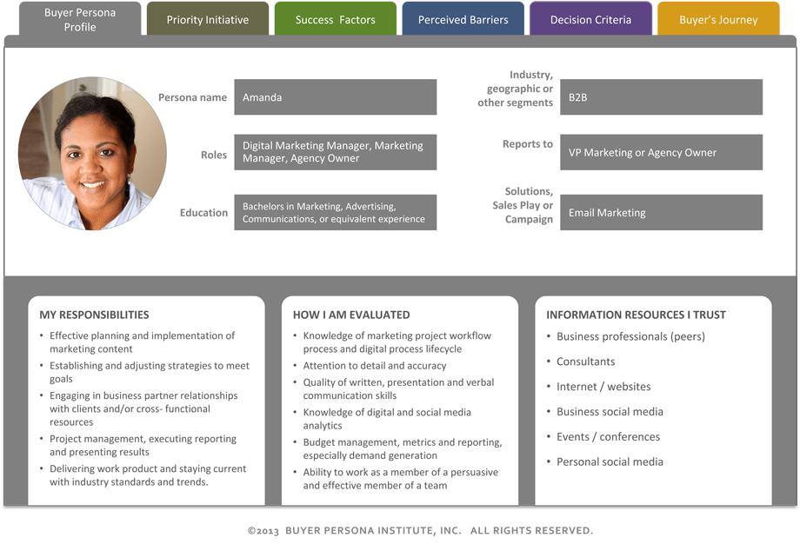
Customer Personas
Content creation
Messaging that appeals
Personalized marketing
Easy channels of communication (Liu et al., 2015)
Notes:
The Hyatta hotels should consider developing personas as the personas are key in creating the business contents.
The business will also be able to send appealing messages to personalized customers.
With this strategy it becomes easy to target or have a personalized market for easy manipulation. Communication is appropriately channeled as it sends the business formats a message putting into consideration the particulars of each customer (Liu et al., 2015).

Slide 7
References
Armstrong, G., Kotler, P., Buchwitz, L. A., Trifts, V., & Gaudet, D. (2015). Marketing: an introduction.
Kwac, J., Flora, J., & Rajagopal, R. (2014). Household energy consumption segmentation using hourly data. IEEE Transactions on Smart Grid, 5(1), 420-430.
Liu, Y., Li, H., Peng, G., Lv, B., & Zhang, C. (2015). Online purchaser segmentation and promotion strategy selection: evidence from Chinese E-commerce market. Annals of Operations Research, 233(1), 263-279.

